Slide 1
BCT 2305: Data Communication
Lecture 1b Digital Communication Basics

Slide 2
Data
Data, refers to a collection of numbers, characters that convey meaning in a specific context
Data is collected and analyzed to create information suitable for making decisions

Slide 3
Communication
Main purpose of communication is to transfer information(message) from a source to a recipient via a channel or medium.
Basic block diagram of a communication system:
Source
Transmitter
Channel
Receiver
Recipient

Slide 4
Brief Description
Source: analog or digital
Transmitter: transducer, amplifier, modulator, oscillator, power amp., antenna
Channel: e.g. cable, optical fibre, free space
Receiver: antenna, amplifier, demodulator, oscillator, power amplifier, transducer
Recipient: e.g. person, (loud) speaker, computer

Slide 5
Types of information
Voice, data, video, music, email etc.
Types of communication systems
Public Switched Telephone Network (voice,fax,modem)
Satellite systems
Radio,TV broadcasting
Cellular phones
Computer networks (LANs, WANs, WLANs)

Slide 6
Information Representation
Communication system converts information into electrical electromagnetic/optical signals appropriate for the transmission medium. Hence the need to understand issues related to EM signals….i.e signal characteristics, synthesis and propagation
Analog systems convert analog message into signals that can propagate through the channel. ….Modulation/demodulation
Digital systems convert bits(digits, symbols) into signals Modulation/demodulatio
  Computers naturally generate information as characters/bits
  Most information can be converted into bits
  Analog signals converted to bits by sampling and quantizing (A/D conversion)

Slide 7
Why digital?
Digital techniques need to distinguish between discrete symbols allowing regeneration versus amplification
Its easy to process. Good processing techniques are available for digital signals. such as.
  Data compression (or source coding)
  Error Correction (or channel coding)(A/D conversion)
  Equalization
  Security
Easy to mix signals and data using digital techniques

Slide 8
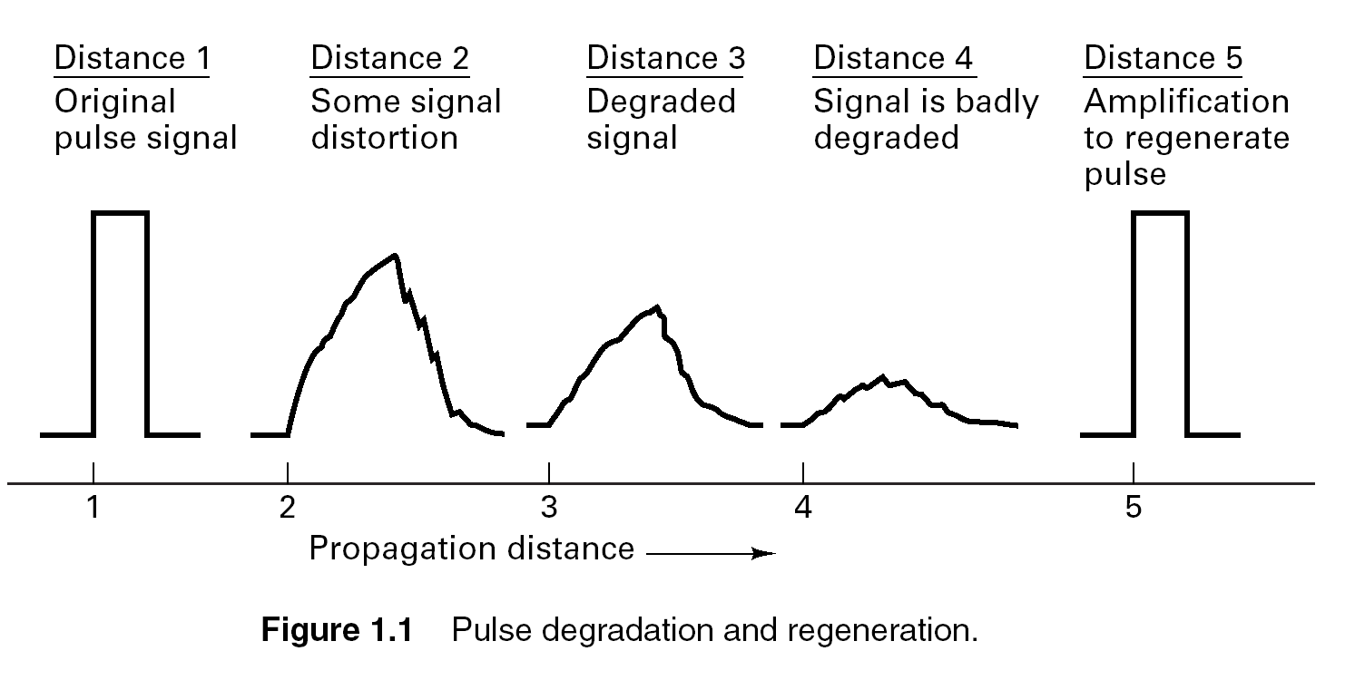

Slide 9
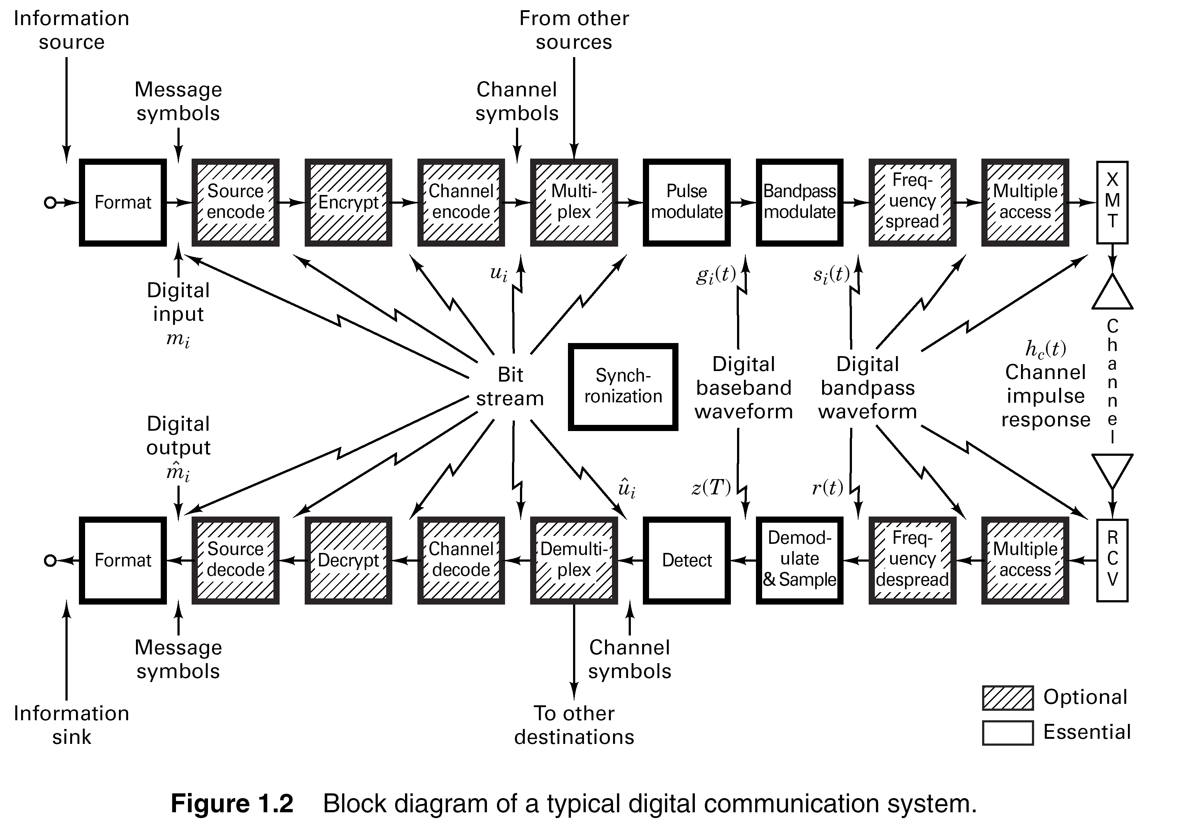

Slide 10
Basic Digital Communication Transformations
  Formatting/Source Coding
  Transforms source info into digital symbols (digitization)
  Selects compatible waveforms (matching function)
  Introduces redundancy which facilitates accurate decoding despite errors
It is essential for reliable communication
  Modulation/Demodulation…..
  Modulation is the process of modifying the info signal to facilitate transmission … why?
  Demodulation reverses the process of modulation. It involves the detection and retrieval of the info signal
    Types
    Coherent: Requires a reference info for detection
    Noncoherent: Does not require reference phase information

Slide 11
Basic Digital Communication Transformations
  Coding/Decoding
  Translating info bits to transmitter data symbols
  Techniques used to enhance info signal so that they are less vulnerable to channel impairment (e.g. noise, fading, jamming, interference)
    Two Categories
      Waveform Coding…AD conversion e.g PCM
    Produces new waveforms with better performance
      Structured Sequences ….?
Involves the use of redundant bits to determine the occurrence of error (and sometimes correct it)
  Multiplexing/Multiple Access Is synonymous with resource sharing with other users
  Frequency Division Multiplexing/Multiple Access (FDM/FDMA

Slide 12
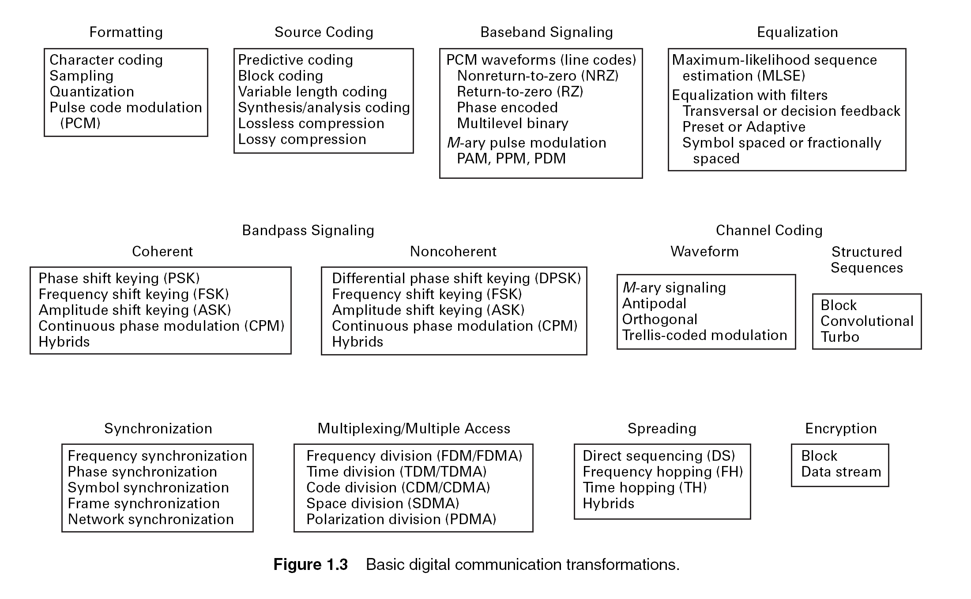

Slide 13
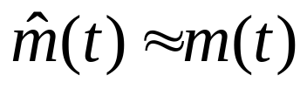
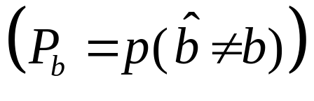
Performance Metrics
Analog Communication Systems
  Metric is fidelity: want
  SNR typically used as performance metric
Digital Communication Systems
  Metrics are data rate (R bps) and probability of bit error
  Symbols already known at the receiver
  Without noise/distortion/sync. problem, we will never make bit errors

Slide 14
Main Points
Transmitters modulate analog messages or bits in case of a DCS for transmission over a channel.
Receivers recreate signals or bits from received signal (mitigate channel effects)
Performance metric for analog systems is fidelity, for digital it is the bit rate and error probability.

Slide 15
Why Digital Communications?
  Easy to regenerate the distorted signal
  Regenerative repeaters along the transmission path can detect a digital signal and retransmit a new, clean (noise free) signal
  These repeaters prevent accumulation of noise along the path
This is not possible with analog communication systems
  Two-state signal representation
The input to a digital system is in the form of a sequence of bits (binary or M_ary)
  Immunity to distortion and interference
  Digital communication is rugged in the sense that it is more immune to channel noise and distortion

Slide 16
Why Digital Communications?
  Hardware is more flexible
  Digital hardware implementation is flexible and permits the use of microprocessors, mini-processors, digital switching and VLSI
Shorter design and production cycle
  Low cost
The use of LSI and VLSI in the design of components and systems have resulted in lower cost
  Easier and more efficient to multiplex several digital signals
  Digital multiplexing techniques – Time & Code Division Multiple Access - are easier to implement than analog techniques such as Frequency Division Multiple Access

Slide 17
Why Digital Communications?
  Can combine different signal types – data, voice, text, etc.
  Data communication in computers is digital in nature whereas voice communication between people is analog in nature
  The two types of communication are difficult to combine over the same medium in the analog domain.
Using digital techniques, it is possible to combine both format for transmission through a common medium
Encryption and privacy techniques are easier to implement
  Better overall performance
  Digital communication is inherently more efficient than analog in realizing the exchange of SNR for bandwidth
  Digital signals can be coded to yield extremely low rates and high fidelity as well as privacy

Slide 18
Why Digital Communications?
Disadvantages
Requires reliable “synchronization”
Requires A/D conversions at high rate( Modulation and Demodulation)
Requires larger bandwidth…why?
Nongraceful degradation
Performance Criteria
Probability of error or Bit Error Rate

Slide 19
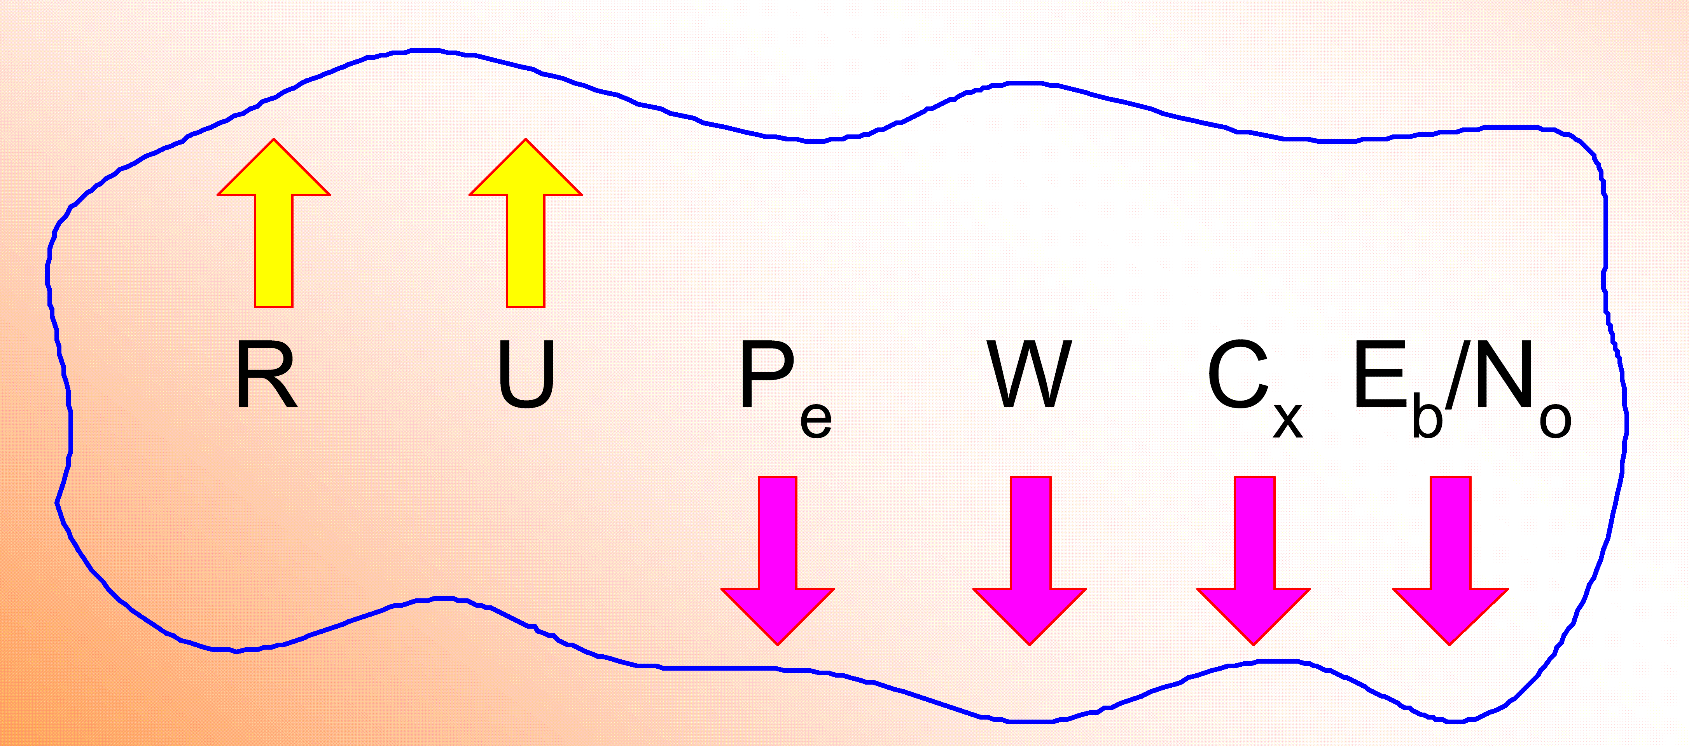
Goals in Communication System Design
To maximize transmission rate, R
To maximize system utilization, U
To minimize bit error rate, P_{e}
To minimize required systems bandwidth, W
To minimize system complexity, C_{x}
To minimize required power, E_{b}/N_{o}

Slide 20
Comparative Analysis of Analog and
Digital Communication

Slide 21
Digital Signal Nomenclature
Information Source
  Discrete output values e.g. Keyboard
  Analog signal source e.g. output of a microphone
Character
  Member of an alphanumeric/symbol (A to Z, 0 to 9)
  Characters can be mapped into a sequence of binary digits using one of the standardized codes such as
    ASCII: American Standard Code for Information Interchange
    EBCDIC: Extended Binary Coded Decimal Interchange Code

Slide 22
Digital Signal Nomenclature
Digital Message
  Messages constructed from a finite number of symbols; e.g., printed language consists of 26 letters, 10 numbers, “space” and several punctuation marks. Hence a text is a digital message constructed from about 50 symbols
  Morse-coded telegraph message is a digital message constructed from two symbols “Mark” and “Space”
M - ary
  A digital message constructed with M symbols
Digital Waveform
  Current or voltage waveform that represents a digital symbol
Bit Rate
  Actual rate at which information is transmitted per second

Slide 23
Digital Signal Nomenclature
Baud Rate
  Refers to the rate at which the signaling elements are transmitted, i.e. number of signaling elements per second.
Bit Error Rate
  The probability that one of the bits is in error or simply the probability of error

Slide 24

1.2 Classification Of Signals
1. Deterministic and Random Signals
A signal is deterministic means that there is no uncertainty with respect to its value at any time.
Deterministic waveforms are modeled by explicit mathematical expressions, example:
A signal is random means that there is some degree of uncertainty before the signal actually occurs.
Random waveforms/ Random processes when examined over a long period may exhibit certain regularities that can be described in terms of probabilities and statistical averages.

Slide 25
2. Periodic and Non-periodic Signals
A signal x(t) is called periodic in time if there exists a constant
T₀ > 0 such that
(1.2)
t denotes time
T₀ is the period of x(t).

